Slide 1
Digital Portfolio
STUDENT NAME: SANTOSH V
REGISTER NO:24132161802521068
NMID:autanm21621624ucse085
DEPARTMENT: COMPUTER SCIENCE
COLLEGE: GOVERNMENT ARTS AND SCIENCE THIRUVENNAINALLUR
UNIVERSITY: ANNAMALAI UNIVERSITY

Slide 2
PROJECT TITLE

Slide 3


AGENDA
Problem Statement
Project Overview
End Users
Tools and Technologies
Portfolio design and Layout
Features and Functionality
Results and Screenshots
Conclusion
Github Link
3/21/2024 Annual Review

Slide 4
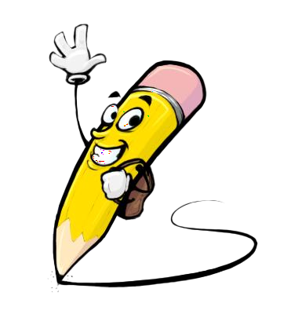
PROJECT OVERVIEW
The Drinking Water Project focuses on solving the global issue of safe water accessibility by designing and implementing innovative, sustainable, and cost-effective solutions.Objectives:To provide clean and safe drinking water to communities.To design a low-cost water purification system that is easy to operate and maintain.To use modern tools and technologies (sensors, IoT, filtration methods) for monitoring water quality.To raise awareness among people about water conservation and safe usage practices.To develop a user-friendly design that can be adapted in rural and urban areas.Overview:This project integrates scientific methods, purification techniques, and digital monitoring systems to ensure water safety. It demonstrates how innovative design and technology can help solve real-life problems, while keeping the solution affordable, eco-friendly, and scalable for future expansion.

Slide 5

PROBLEM STATEMENT
Access to clean and safe drinking water remains one of the most critical challenges faced by society today. A large portion of the global population still depends on contaminated or unsafe water sources, leading to serious health hazards such as waterborne diseases (cholera, diarrhea, typhoid).Key issues include:Water Contamination – Due to industrial waste, sewage, agricultural runoff, and chemical pollutants.Scarcity of Clean Water – Unequal distribution and depletion of freshwater resources.Lack of Awareness – Many people are unaware of safe storage and purification practices.High Cost of Solutions – Existing purification technologies are expensive for rural and underprivileged communities.This project aims to address these challenges by developing a sustainable, affordable, and effective system to ensure the availability of safe drinking water for all sections of society.

Slide 6

WHO ARE THE END USERS?
The project is designed to benefit a wide range of people and organizations that face challenges in accessing clean and safe drinking water:Rural CommunitiesVillages and remote areas with limited infrastructure and no access to modern water purification systems.Urban HouseholdsFamilies in cities and towns who rely on municipal water supply but often face contamination issues.Schools & CollegesEducational institutions where large groups of students need safe drinking water on a daily basis.Hospitals & Health CentersMedical facilities where pure water is essential for patients, sanitation, and overall healthcare delivery.Government & NGOsOrganizations that implement water supply projects and awareness programs in affected regions.Industries & WorkplacesFactories, offices, and other workplaces where employees require continuous access to safe water.

Slide 7

TOOLS AND TECHNIQUES
To design, implement, and evaluate the Drinking Water Project effectively, the following tools and techniques are used:1. Water Purification TechniquesFiltration Methods – Sand filtration, membrane filtration, and activated carbon.Chemical Treatment – Chlorination, ozonation, and UV sterilization.Reverse Osmosis (RO) – For removing dissolved salts and impurities.2. Monitoring ToolsIoT Sensors – For real-time water quality monitoring (pH, TDS, turbidity).Data Loggers & Cloud Systems – To collect and store water condition data.Mobile Applications / Dashboards – To display water quality reports for users.3. Design and Development ToolsCAD Software (AutoCAD, SolidWorks) – For system design and layout.Simulation Tools – To test water purification models virtually.Programming & IoT Platforms – Arduino, Raspberry Pi, and Python for automation.4. Project Management & DocumentationMS PowerPoint / MS Word – For project presentation and reporting.Excel / Data Analytics Tools – For analyzing water quality test results.Version Control (GitHub) – For managing project design files and software.

Slide 8
POTFOLIO DESIGN AND LAYOUT
8

Slide 9
FEATURES AND FUNCTIONALITY

Slide 10

RESULTS AND SCREENSHOTS
3/21/2024 Annual Review
10

Slide 11
CONCLUSION
11

